Slide 1
TREChub
A Hub for Testing and Improving Information Retrieval Systems

Slide 2
What is trec?
Trec stands for “Text Retrieval Conference,” the event is sponsored by NIST (National Institute for Standards and Technology) and the US Department of Defence. TREC started in 1992 to support research in the field of information retrieval by providing a way for researchers to test their information retrieval systems on large quantities of data.
Now TREC hosts a series of competitions each year aimed at further aiding the development of information retrieval systems. In these competitions there are various tracks which are a series of tasks which require the participants to take a large amount of data and perform queries using their information retrieval systems to sort them by their relevance to a set of given requirements.
The participants respond by uploading data that normally includes a list of documents that they feel are the most relevant to the task’s specifications. Their lists are evaluated based on different criteria and varying degrees of feedback are given, based on the task.
More information on TREC can be found at “trec.nist.gov”

Slide 3
What Does TREChub Do?
TREChub aims to provide a service where users (researchers and non-researchers alike) can view information about the various tracks that are currently available to participate in. Researchers will be able to login and create an account where they will be able to share a little about themselves and post links to their own websites.
Researchers will be able to participate in tracks, where they are allowed to view the tasks and upload their submissions for each task. The evaluation software will offer feedback based on varying criteria, while other researchers as well as well as non-researchers can view statistics relating to the results of the submissions in different forms (e.g. ranking and graphs)
What does a track look like?
A track is given an associated field: A brief description of what the problem domain is, e.g. “Contextual Suggestion Track,”
this track would look at complex information needs based on user interests, etc.
A track is given a query type: This describes what data is to be submitted by the participant, for example; a list document titles;
a list of descriptions; etc.
A track is given a feedback type: participants may be given relevance feedback, pseudo-feedback, no feedback, etc.

Slide 4


Users
Researcher
Non-Researcher

Slide 5
Users
Researcher
Details | Goals
Intermediate/expert computer user with years of experience in the IT industry. Employed within a company or freelance working in an office environment. Stationed anywhere in the world with varying Internet connection speeds. Collection, analysis and interpretation of data. Identifying and reviewing problems and communicating research findings. | Re-evaluation of search system to seek further improvement. Application should help researcher identify areas of improvement. Researcher will want to compare current system to other systems.

Slide 6
Users
Non-Researcher
Details | Goals
Type of computer user can vary from casual to expert. This user will not be driven to the application to assess their own search system. Browsing these type of applications can be a spare time activity by non-researchers. A typical non-researcher will not be familiar with the same technical terminology used by researchers. | User may want to inspect the current best search systems for their own or commercial use. User wants to benefit from features such as ordering and comparing tabulated results. Non-researcher does not want to feel intimidated. Technical terminology used by researchers should be accessible via account.

Slide 7
User Personas
Paula Scott, Researcher
Victor Brooks, Non-Researcher
35 years old, holds a CS degree.
Has been working as a software engineer in a mid-sized company for 6 years.
Together with a team, faces the challenge to improve search system.
28 years old, creative casual computer user.
Interested in technology and writing.
Updates his blog on a weekly basis and writes about latest web application developments.

Slide 8
Features
Researchers can create profiles to communicate with other researchers by creating a user bio, as well as uploading a profile picture and having a link to their own websites.
Researchers can participate in treks to assess their information retrieval systems and compete with other researchers for a place in the rankings.
Evaluation and feedback allow researchers to see issues with their information systems and allows them to see the strengths and weaknesses of their system, as well as see how their systems compare to those of other researchers.
Both researchers and non-researchers can view detailed statistics to see how well current retrieval systems are performing in completing tasks as well as seeing which systems are performing the best.
User Profiles
Participation in trecs
Evaluation
Feedback
Statistics and rankings

Slide 9
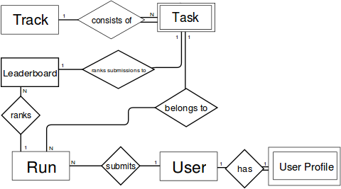
ER Diagram

Slide 10
ER Attributes

Slide 11
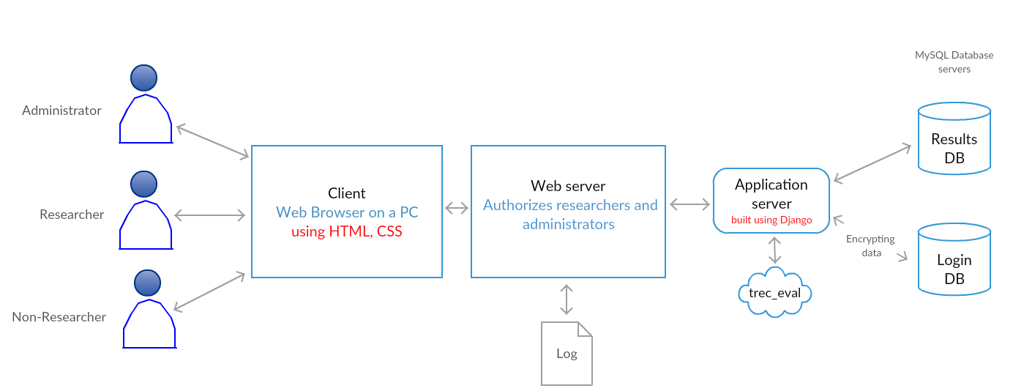
System Architecture

Slide 12
DB Design

Slide 13
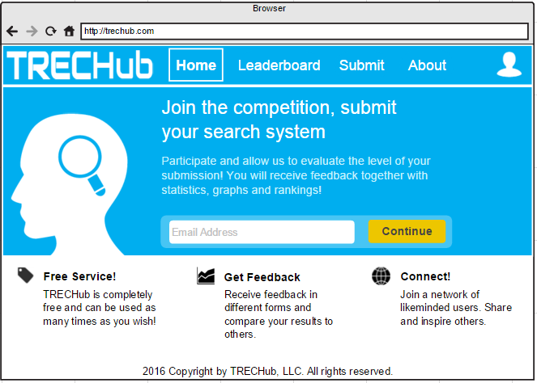
Wireframes
http://trechub.com

Slide 14
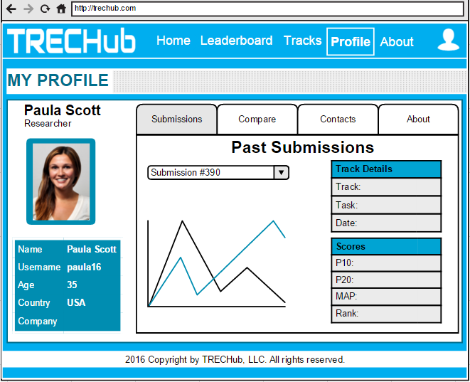
Wireframes
http://trechub.com/paula16

Slide 15
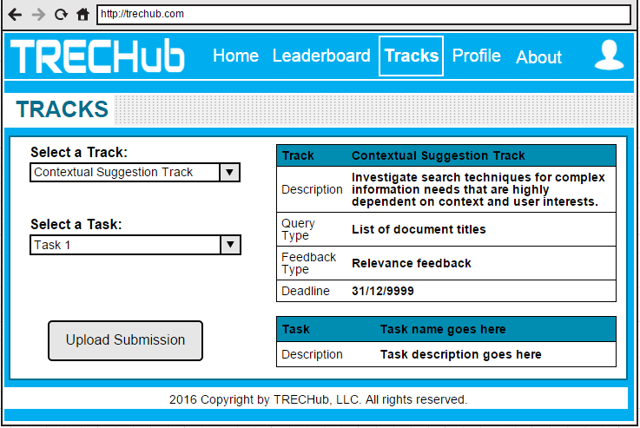
Wireframes
http://trechub.com/tracks

Slide 16
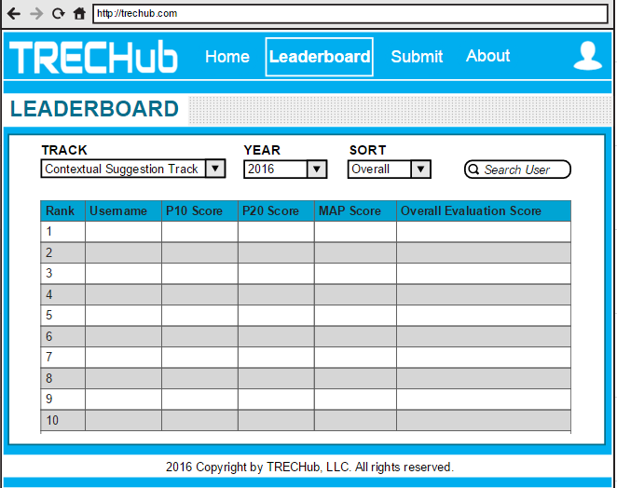
Wireframes
http://trechub.com/leaderboard

